Slide 1
National Tripartite Event
GEORGIA
EOSC and Open Science in National Science Library of Georgia
Nino Pavliashvili
National Science Library of Georgia
2-4 November 2022

Slide 2
Promoting Science and Supporting Scientific Research has always been the main mission for the National Science Library of Georgia
Material fund:
Over 4 million of printed editions
20 million of patents and standards
E-Book Collections
E-Bases: e-Journals, e-Books, databases
Digital Repositories

Slide 3
Openness – core value
Open Science at the National Science Library
Raising awareness and providing training Open Education Resources
Supporting Citizen Science
Developing Infrastructure for Open Access
Policies for Open Access
Promoting open-source softwares
Being part of International Communities working for Open Science Advancement

Slide 4
Open-Source Open Digital Resources:
Library Catalog
Repository Openlibary.ge
Platform Openjournls.ge
Repository Openscience.ge

Slide 5
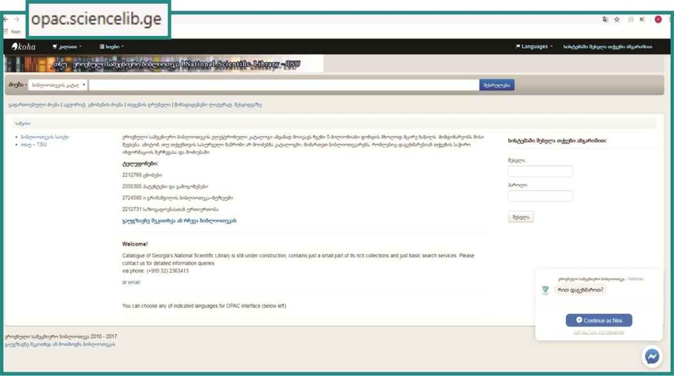
Online Library Catalogue of NSL
Catalogs printed and electronic funds of the National Science Library
Provides digital footprint of published Georgian literature with high standard metadata
Open-source platform
http://opac.sciencelib.ge/

Slide 6
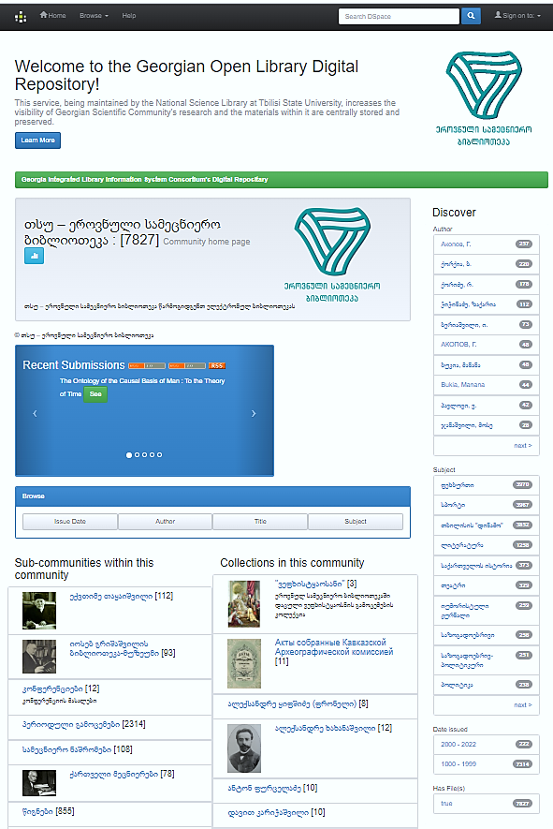
OPENLIBRARY.GE
Digital Repository of open-access Electronic, Scanned and Digitized Publications, Books, Periodicals, Old Manuscripts
DSpace-based open-source platform

Slide 7
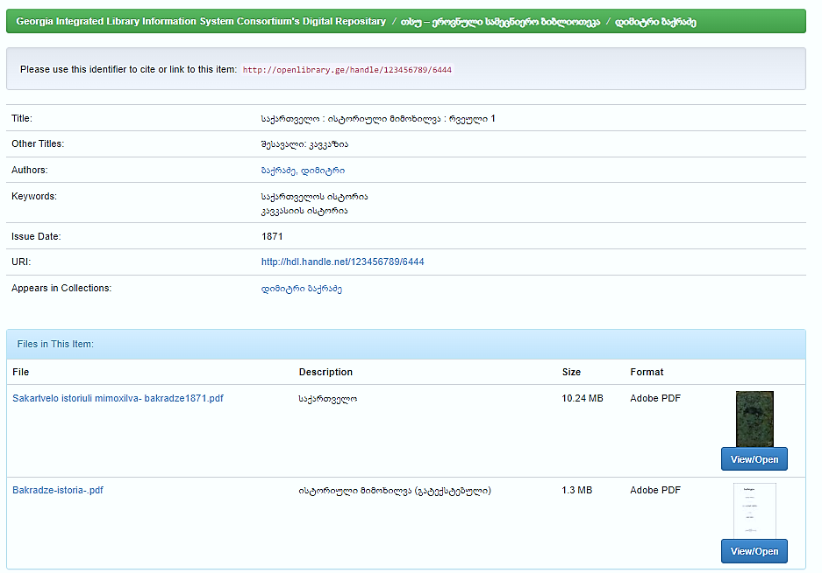
OPENLIBRARY.GE
Example: Search result by Author

Slide 8
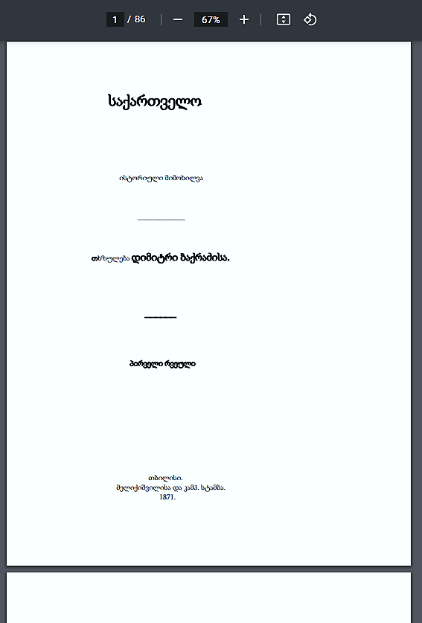
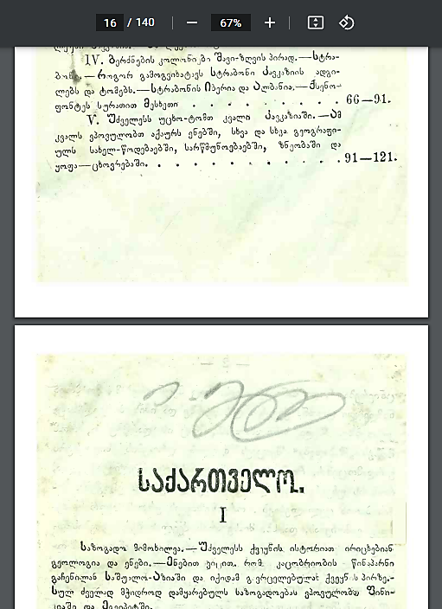
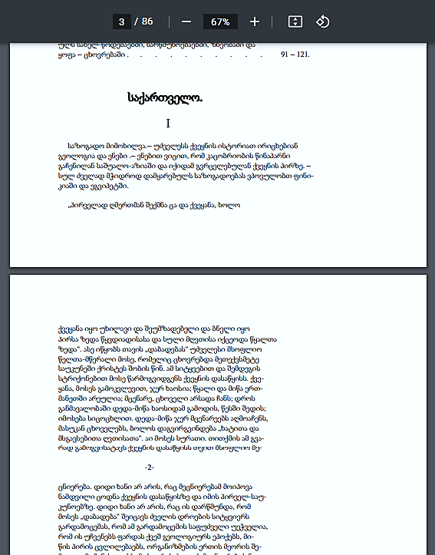

Slide 9
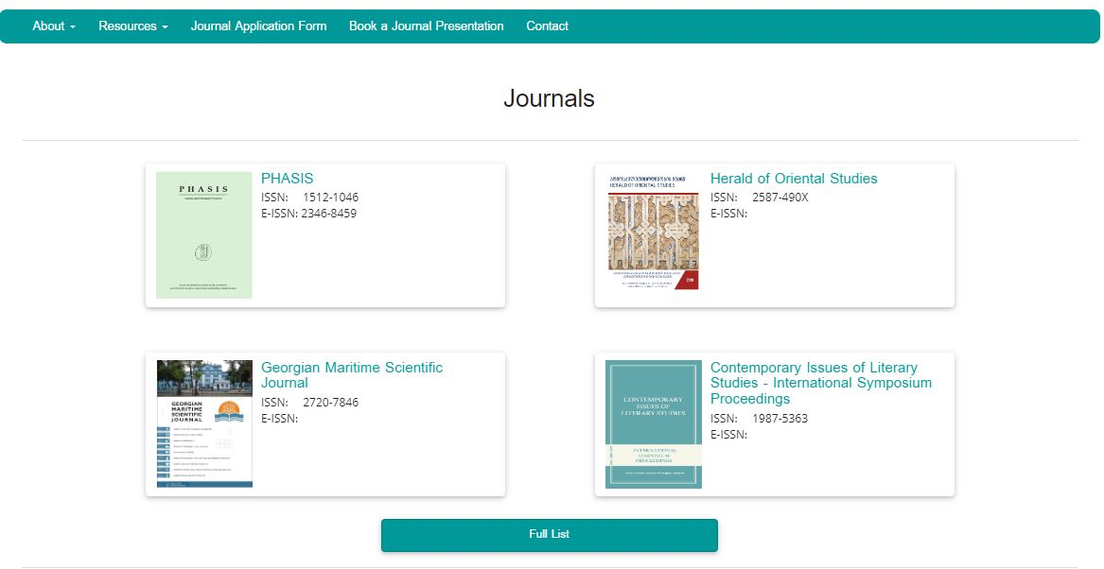
OPENJOURNALS.GE
The Platform for open-access academic journals published in Georgia
OJS-based open-source platform
45 academic journals
20 academic organizations
Funded by the EIFL Small Grants Program

Slide 10
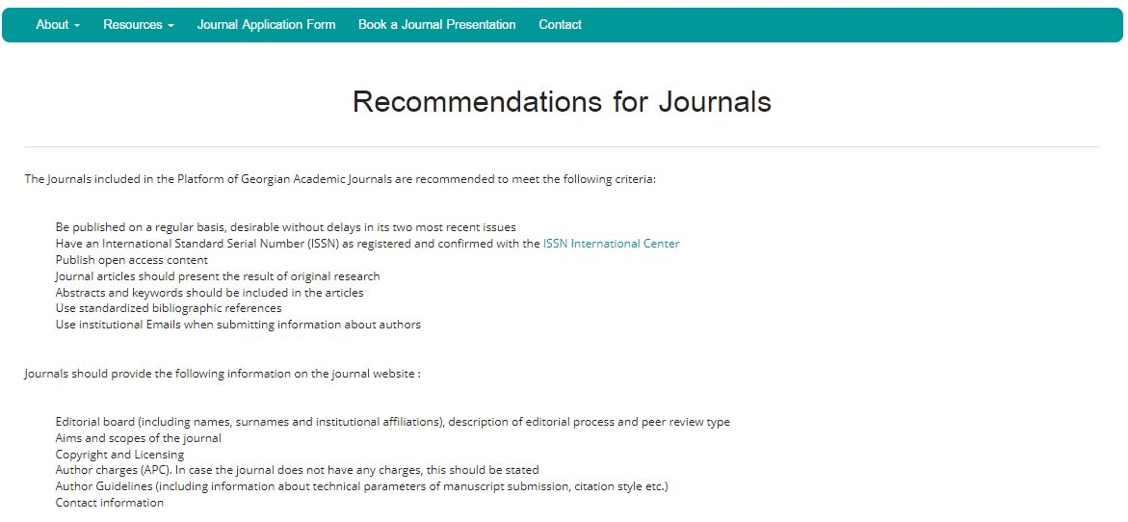
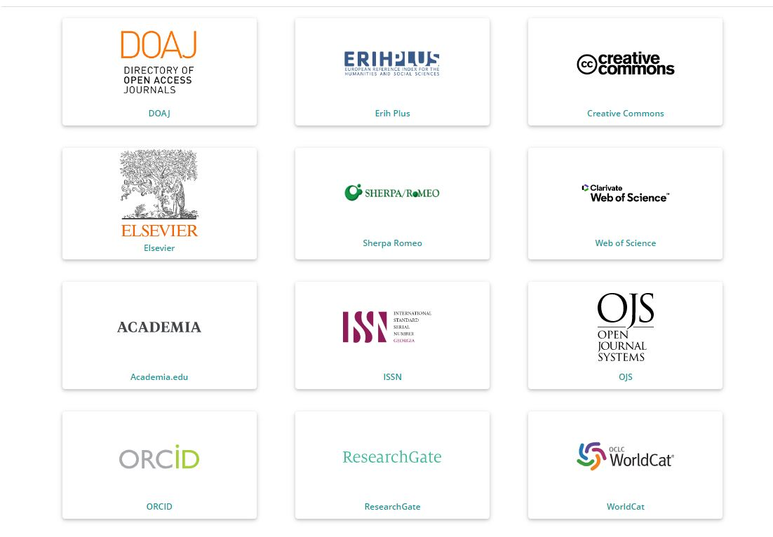
OPENJOURNALS.GE
Resources for authors and editors
Recommendations for journals

Slide 11
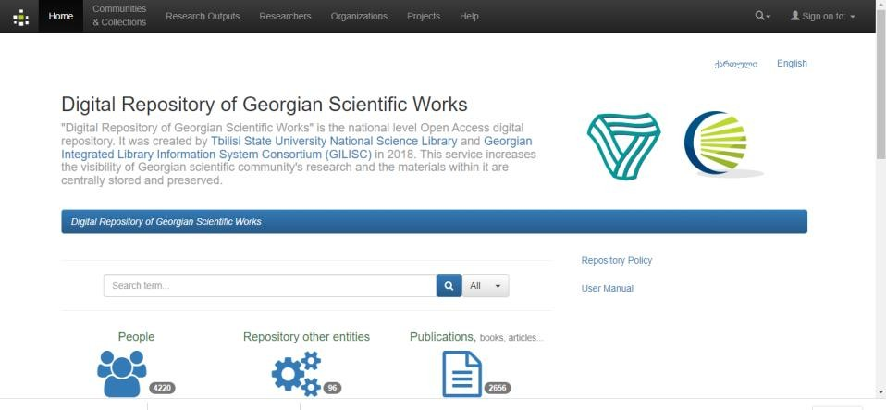
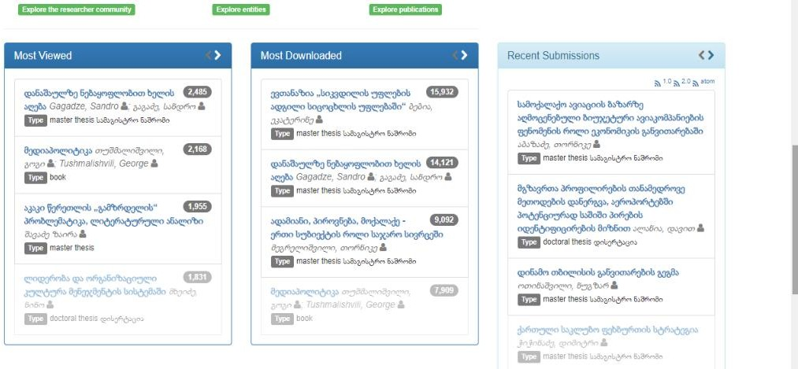
OPENSCIENCE.GE
The repository for Georgian Scientific Works
National Scale Digital Repository, created in 2018, In compliance with Open Science Principles.
Holds research outputs (theses, monograpies, publications) and information about researchers, research organizations, scientific journals, conferences, projects

Slide 12
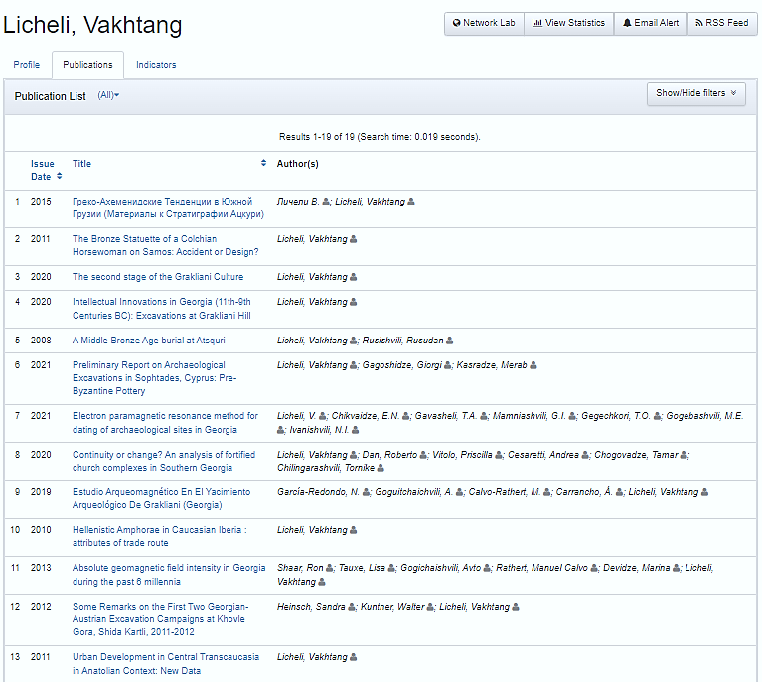
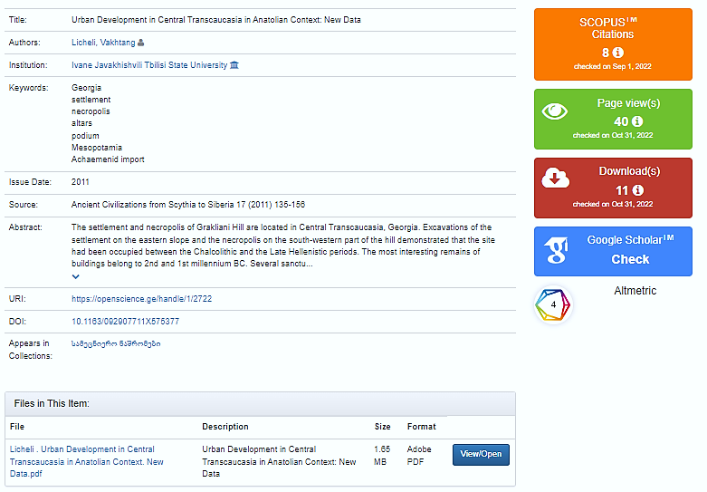
Example: Publication and Statistics
Openscience.ge

Slide 13
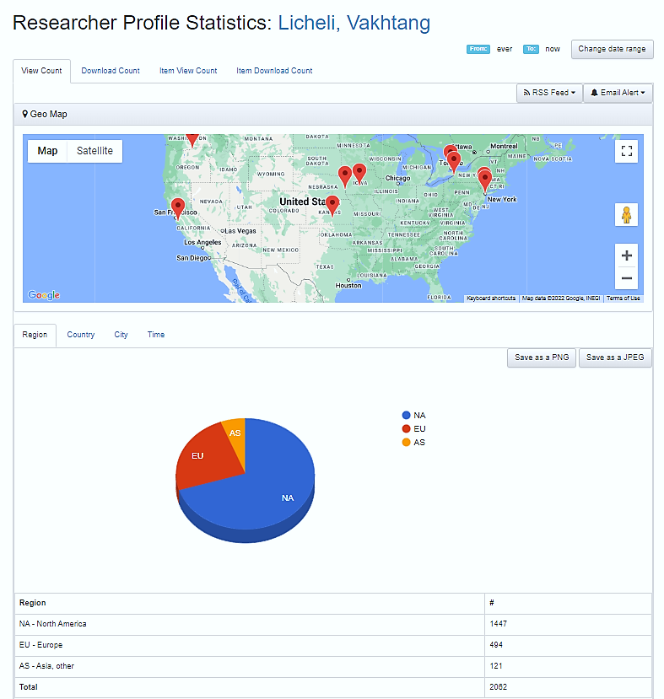
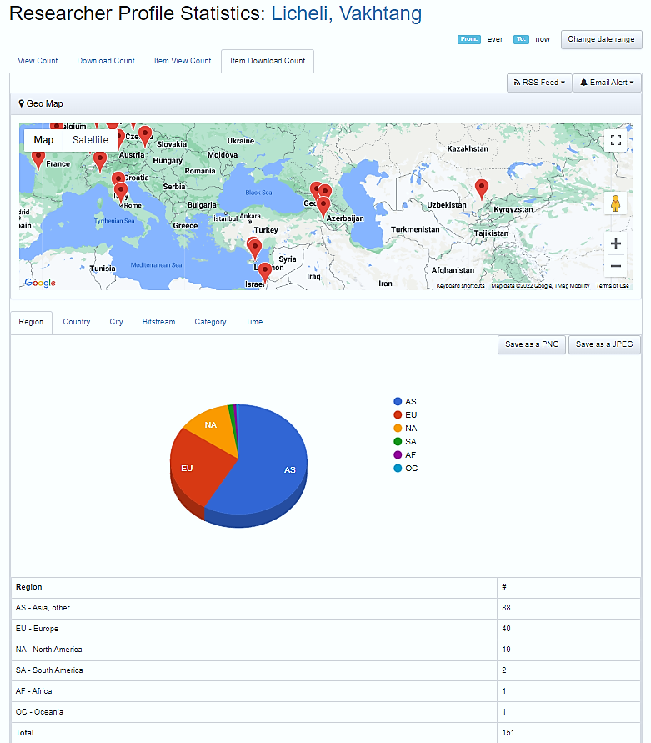
Example: Researcher profile statistics
Openscience.ge

Slide 14
OPENSCIENCE.GE is the first Georgian repository on
European Open Science Cloud

Slide 15
Our path to the EOSC
Catalog of National Initiatives for Open Science in Europe.
Catalogue of Open Access Infrastructure for Research in Europe
Catalogue of the European Association for CRIS
Catalogue of open access repositories

Slide 16
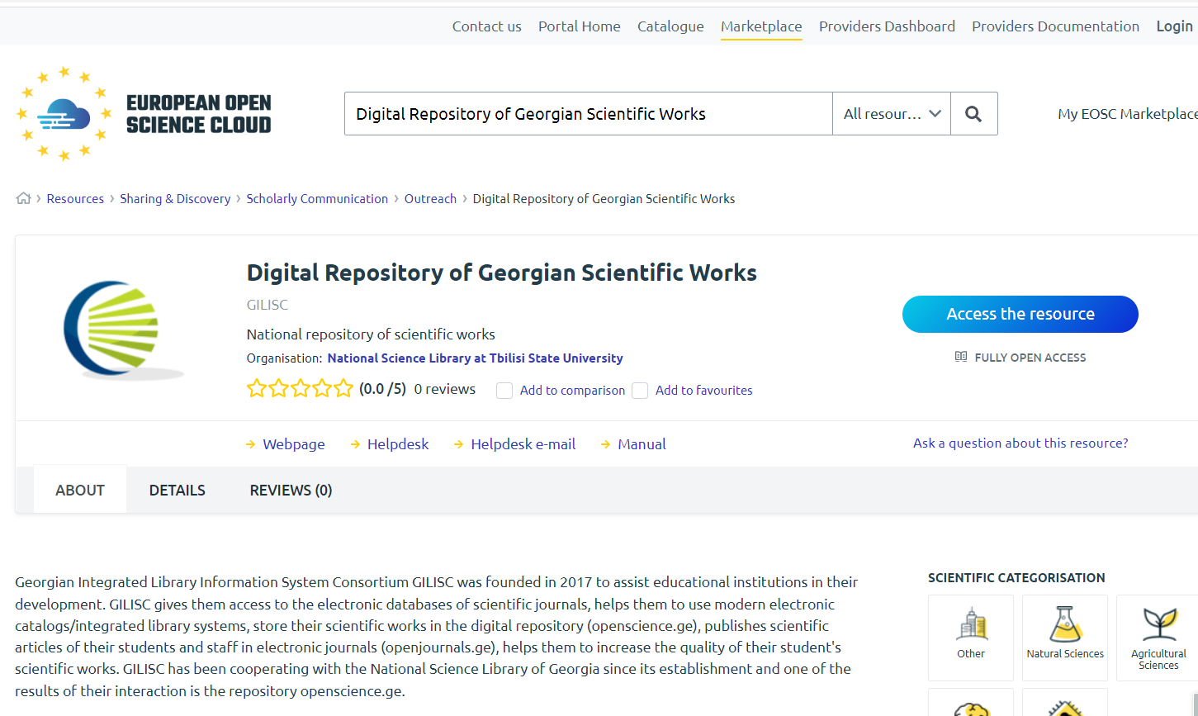
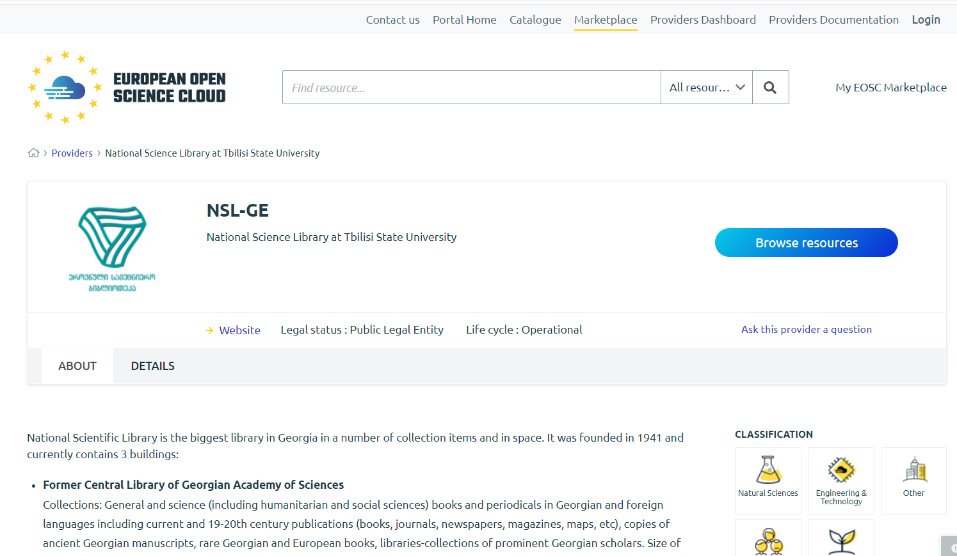
openscience.ge in EOSC

Slide 17
Challenges accepted in 2022
Becoming Member of International Workgroups Working on Open Science
Participation in working groups within communities of librarians
Observer of the EOSC Steering Board
Participating in Open Science policymaking
opescience.ge fully integrated in EOSC

Slide 18
Perspectives
Enriching existing repositories with OS quality material
Supporting Research Data Management with infrastructure
Provide wide arrays of trainings and workshops for awareness raising and capacity building

Slide 19
Thanks for your attention!
Nino Pavliashvili
nino.p@sciencelib.ge
http://www.sciencelib.ge www.openscience.ge

