Slide 1
National Tripartite Event
GEORGIA
OS&EOSC – Achievements and Future Insights
Experience of TECHINFORMI
Dr. Marina Razmadze
Deputy Director, TECHINFORMI
mrazmadze@rustaveli.org.ge

Slide 2
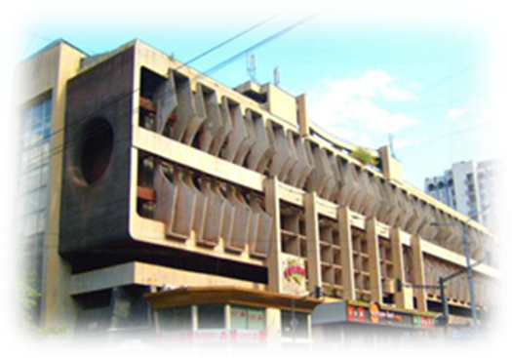
Institute for Scientific and Technical Information -TECHINFORMI
The main purpose of the Institute TECHINFORMI is reflection of the scientific potential of Georgia, dissemination of scientific products, formation and development of scientific and information resources, information support for science and education, analytical and scientometric services.

Slide 3
Department of Information Resources and Analysis;
Department of Development of Information Technologies.
Consultation for a wide variety of national and international institutions;
Reflecting the scientific potential of Georgia and dissemination of Scientific Products;
Building up Scientific Information Resources;
Online registration of current and completed Research Studies;
Customer services in all branches of Market Research;
Information and Analytical Services;
Provision of Scientometric Analysis for Georgian Scientists;
Information support to Science and Education;
Organization of scientific and business events, workshops, exhibition and etc.
Translating/publishing different scientific, technical and other documents.
KEY FUNCTIONS AND OBJECTIVES

Slide 4
Information Resources/Databases:
Georgian Scientists Research projects;
Georgian Scientific publications;
Publications of Georgian Scientists in top-rated foreign journals;
Abstracts of dissertations defended in Georgia
Georgian Scientists deposited works;
Georgian Experts/Scientists database;
Innovations and Technologies;
Scientific Organizations;
FAO depository library’s electronic catalogue
DATABASES

Slide 5
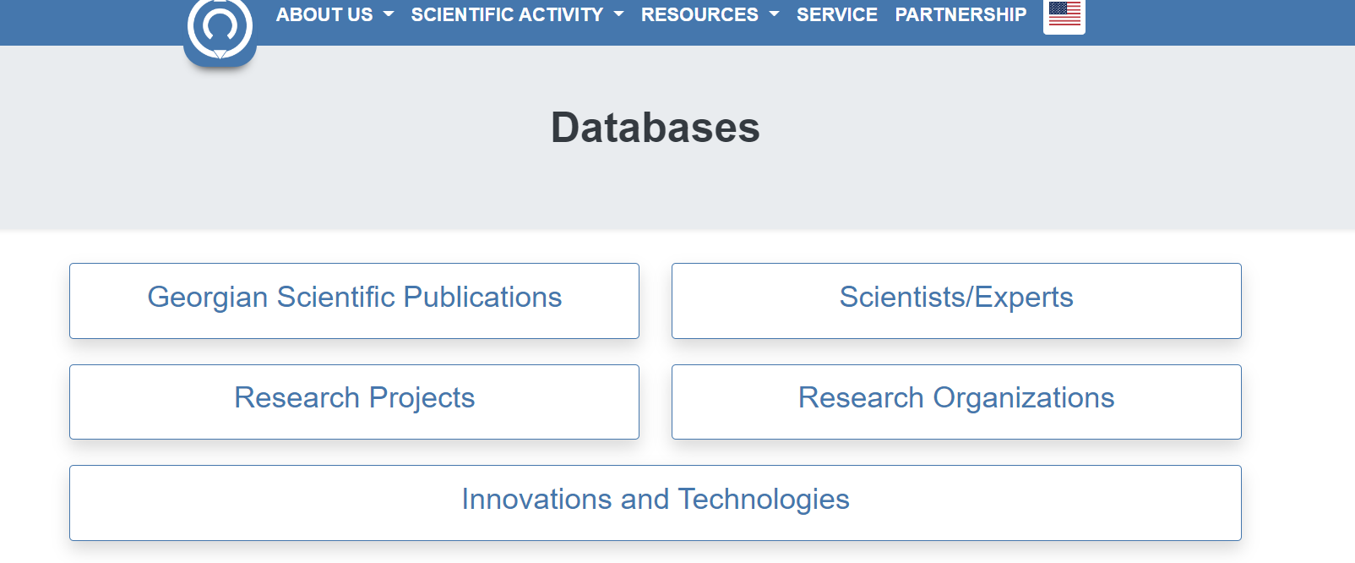
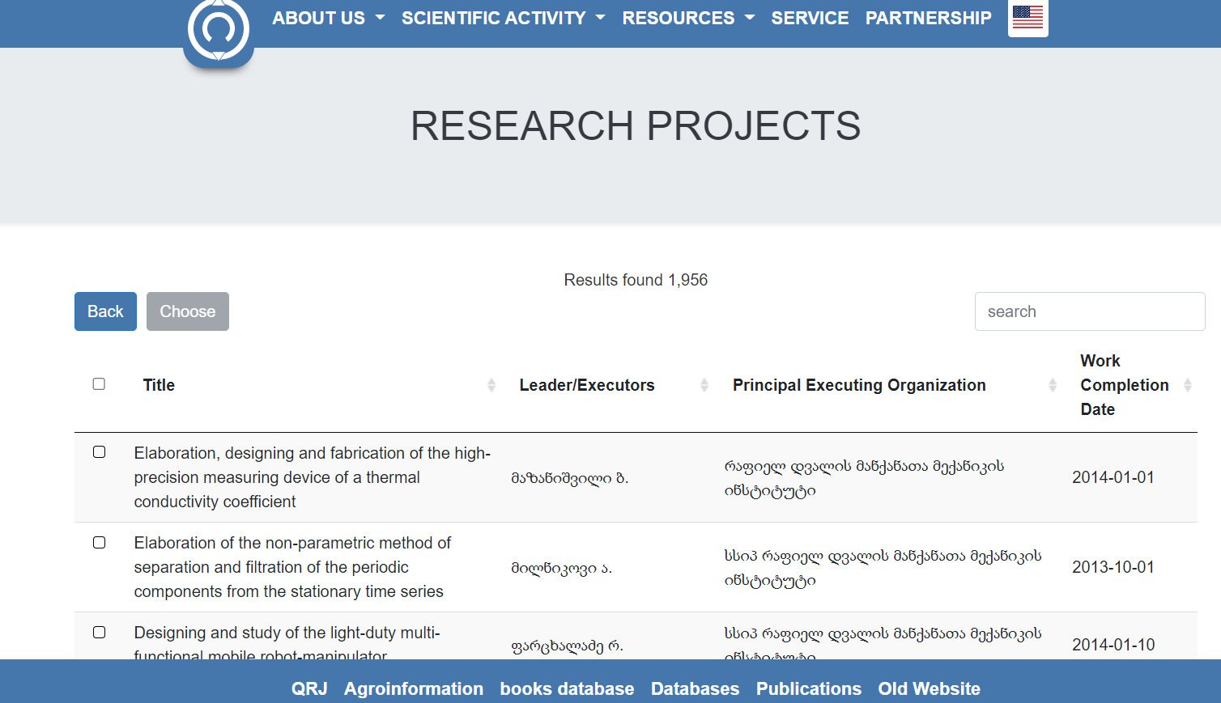
ONLINE REGISTRATION SYSTEM OF RESEARCH PROJECTS
https://www.techinformi.ge/kvlevebi/login.php

Slide 6
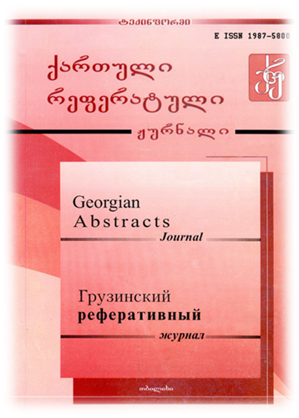
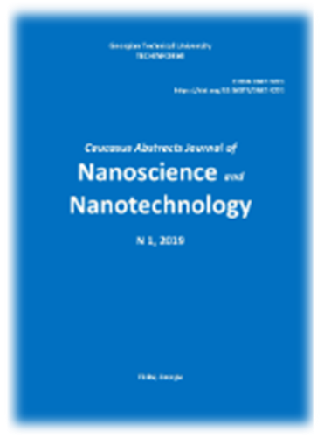
GAJ periodical abstracts journal, bringing together abstracts of Georgian periodicals of scientific and technical sphere, collected papers, deposited works, dissertations and scientific monographs of research institutions and universities from all areas of science.
CAJNN covers scientific periodicals, collected works/articles of educational and research institutions, materials of conferences, dissertations, monographs, and other scientific publications abstracts of Armenia, Azerbaijan and Georgia.
GEORGIAN ABSTRACT JOURNAL (GAJ) and CAJNN

Slide 7
GEORGIAN
TERMINOLOGY
ASSOCIATION
GEORGIAN
https://www.termcat.cat/en/recursos/productes-multimedia/terminology-europe-map?fbclid=IwAR1IlQfxpd6yRByr6FPULhaq3i41hpi0R_H_OK_FpQi2kZztL6Q6tNzA970

Slide 8
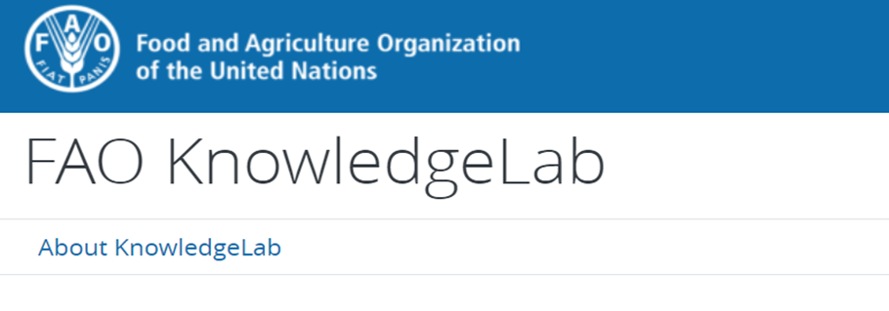
FAO OS SERVICES &
TECHINFORMI
GFAR is an open forum

Slide 9
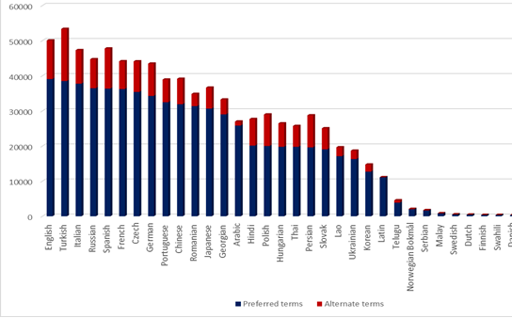
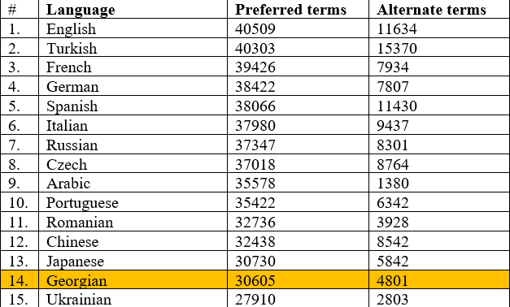
Official editor from Georgia since 2016
AGROVOC MULTILINGUAL THESAURUS
TODAY
over 30,500 Preferred terms and over 4,801 Alternative terms
Linked Open Data Set
about agriculture available for public use and facilitates access and visibility of data across domains and languages. It offers a structured collection of agricultural concepts, terms, definitions and relationships which are used to identify resources, allowing standardized indexing processes and making searches more efficient. AGROVOC uses semantic web technologies, linking to other multilingual knowledge organization systems and building bridges between datasets.
Cooperate with different domain experts in order to determine and prove Georgian Terminology
more than 38,000 concepts and more than 800,000 terms in up to 40 languages.

Slide 10
International System for Agricultural
Science and Technology
AGRIS NATIONAL HUB
14 million publications in free access
up to
90 different languages
AGRIS is one of the powerful agricultural web portals which gives access to the world class information resources and plays an important role for information sharing, accessing and distribution among the agriculture communities in Georgia.
https://www.fao.org/agris/ru/news/agris-user-guide-now-available-georgian
More than
500
institutions
since 2020 - AGRIS Hub in Georgia
TECHINFORMI as the AGRIS Country Hub in Georgia strives to participate in a joint action of data providers from different countries to contribute to the common effort to reduce the gap in accessing scientific information and digital data in food and agriculture.
TODAY
over 3,000 Publications/Books/Conference papers uploaded in AGRIS
150
countries
More than 400,000 visitors and views per month

Slide 11
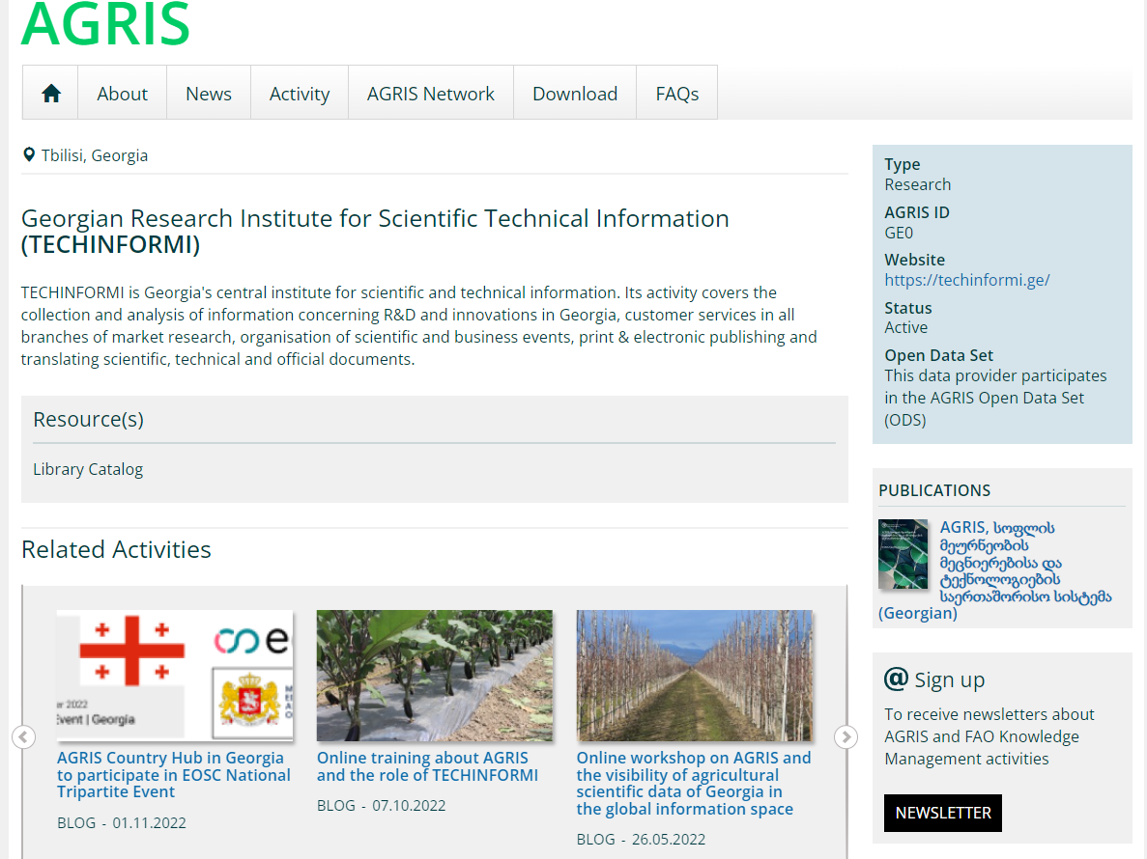
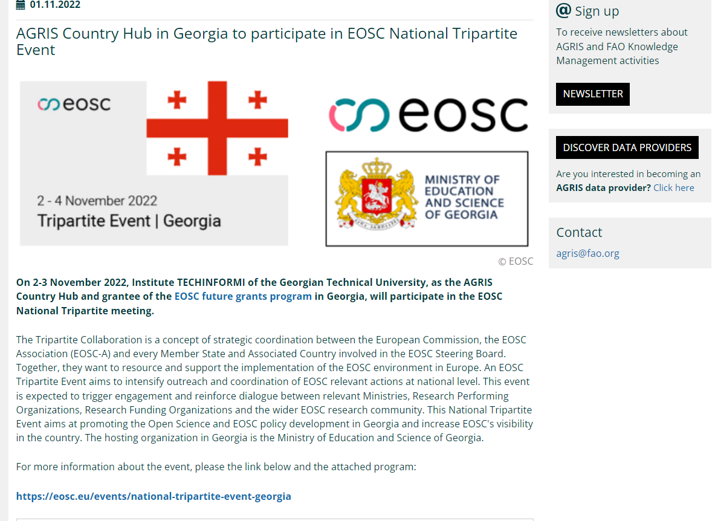
On 2-3 November 2022, Institute TECHINFORMI of the Georgian Technical University, as the AGRIS Country Hub and grantee of the EOSC future grants program in Georgia, will participate in the EOSC National Tripartite meeting.
INSTITUTIONAL KNOWLEDGE SHARING PORTAL
https://www.fao.org/agris/news/agris-country-hub-georgia-participate-eosc-national-tripartiteevent?fbclid=IwAR3tfTWAZoj5cseHJ3fhXo9L9JSRleqYQ806PxI1ZBQMdcJwjbu9bQPN_qQ

Slide 12
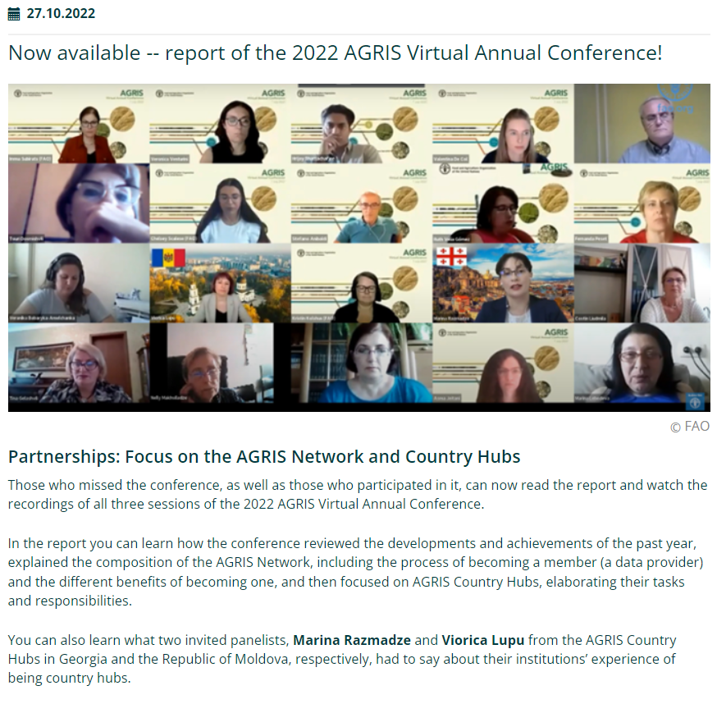
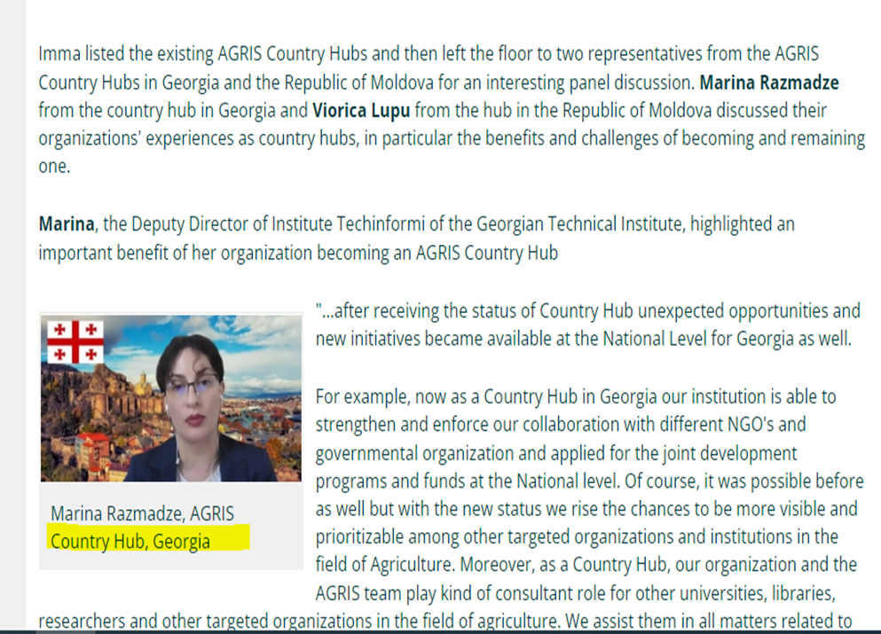
AGRIS ANNUAL CONFERENCE
CO-ORGANISOR
https://www.fao.org/agris/2022-agris-virtual-annual-conference-report

Slide 13
More than 10 awareness trainings during the (2020-2021) and two roundtables in 2022 about Open Science in Agriculture among researchers, MA and PhD students, Academy of Agricultural Sciences and etc.
Current grant with FAO:
“Consolidating the AGRIS National Hub in Georgia to increase awareness about Open Science in Agriculture and train researchers and practitioners in new trends on agricultural research”
SOME ACHIEVEMENTS
Joining RDA IGAD Working group:
RDA is a global initiative whose goal is to develop tools, infrastructures, standards, best practices and activities that enable researchers around the world and across all disciplines and domains to openly share and re-use data. Interest Group for Agricultural Data (IGAD) is a domain-oriented interest group working on all issues related to food and agricultural data important for the development of global agriculture.
Joining the National and UNESCO Open Science teams:
European Open
Science Cloud EOSC Initiative in Georgia
Join the national OS initiatives and working group, curated by the Ministry of Education and Science of Georgia since August;
Became a member of UNESCO’s Working Group on Open Science Monitoring since September.

Slide 14
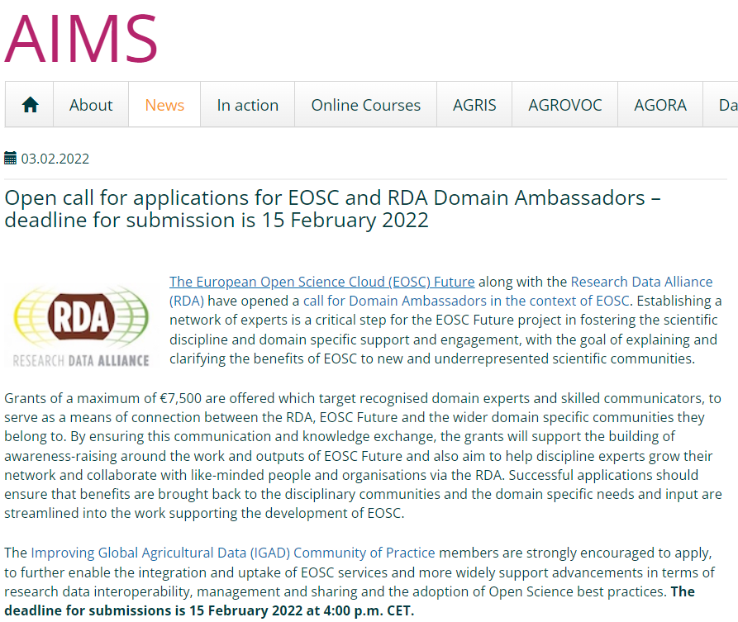
Expanding the IGAD CoP and EOSC in South Caucasus Region – Georgia, Armenia and Azerbaijan
As a AGRIS Country Hub, Institute TECHINFORMI joined in August the European Open Science Cloud (EOSC) Future project, focused on Communities of Practices and coordinated through the Research Data Alliance (RDA).
Involvement of TECHINFORMI in EOSC
The Interest Group on Agricultural Data (IGAD) promotes good practices in the research domain, including data sharing policies, data management plans, and data interoperability. It is the forum for sharing experiences and providing visibility to research and work in agricultural data.
The EOSC Future project is co-funded by the European Union Horizon Programme call INFRAEOSC-03-2020 - Project ID 101017536

Slide 15
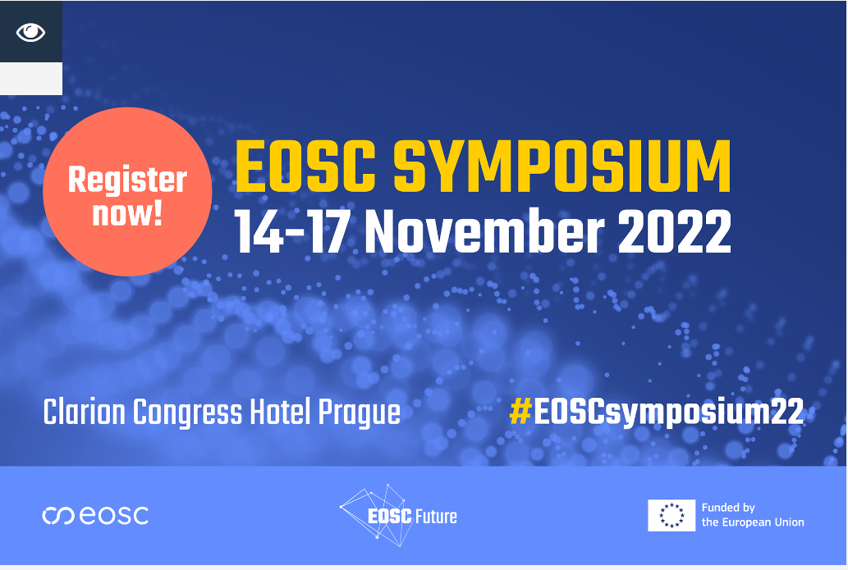
PRESENT PLANS
On November 14-17 with the National OS Group Coordinator will participate in EOSC Symposium 2022 (Czech Republic, Prague) where we will present the main obstacles and demonstrate the strategic vision of the Ministry of Education and Science of Georgia regarding the development OS policy and integration of Georgian scientific ecosystem in to the EOSC.
https://eosc-portal.eu/events/eosc-symposium-2022

Slide 16
Thank you for your attention!

